Slide 1

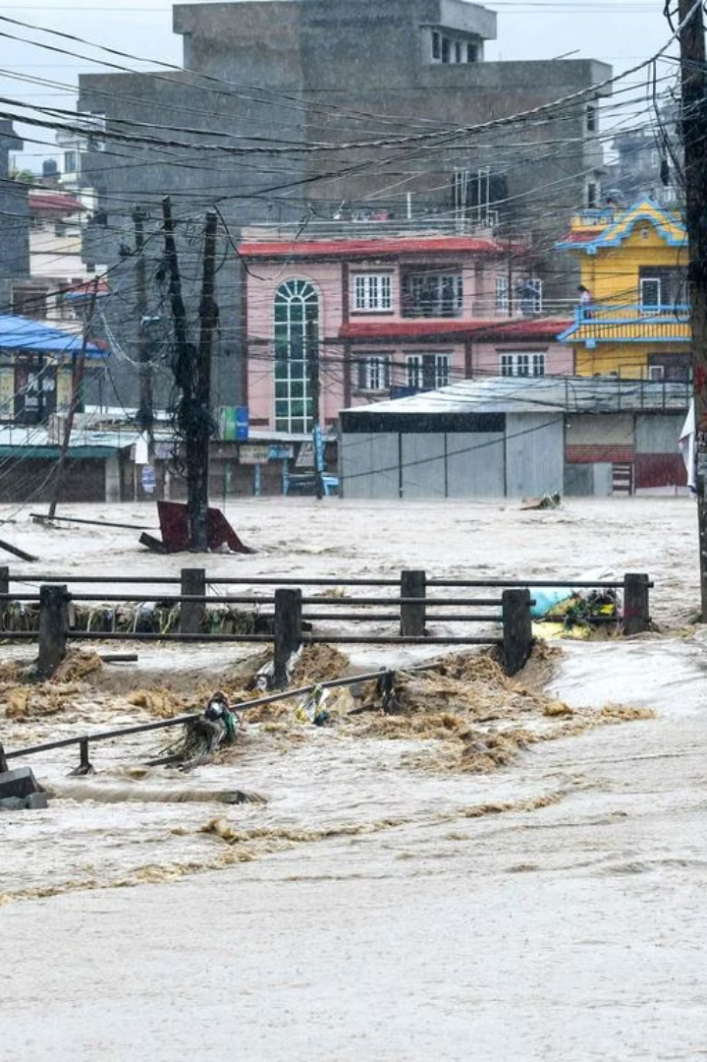
Smart Flood Detection System: Safeguarding Nepal's Communities from Monsoon Disasters
This presentation addresses the critical challenge of water damage in Nepal.
Our Arduino-powered solution offers early leak and flood detection.
We focus on monsoon resilience, aiming to reduce human and economic losses.
Notes:
1

Slide 2
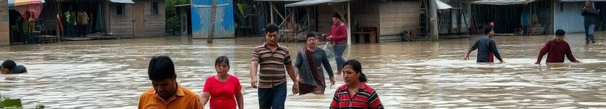
The Challenge: Nepal's Monsoon Vulnerability
Nepal's annual monsoon brings 80% of its rainfall.
It causes over 300 landslides and floods each year.
These disasters result in significant economic and human tolls.
Annual economic loss: | Rs 32cr/year
Lives lost annually: | 1000+
People affected since 2018: | 1.2M+
Notes:
2

Slide 3
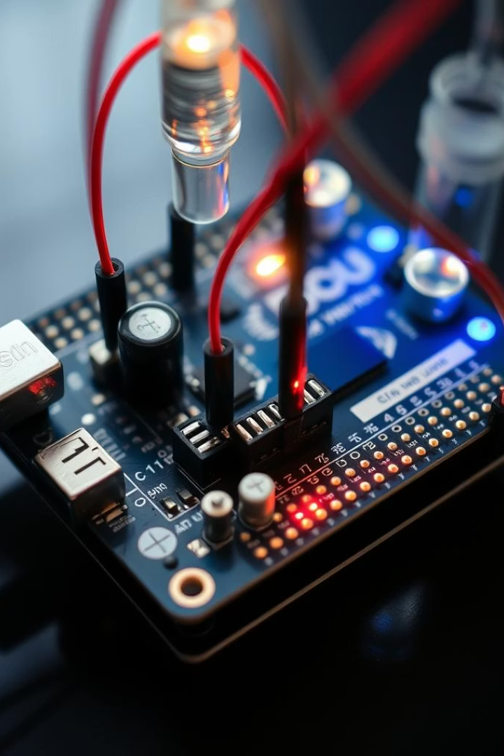
Our Solution: Arduino-Powered Precision
Our system provides real-time water detection for leaks and floods.
Real-time Detection
Monitors water presence, overflow, and flooding instantly.
Automated Alerts
Sends alert notifications to users.
Proactive Prevention
Safeguards homes, infrastructure, and agriculture from damage.
Cost-Effective
Low-power, adaptable, and budget-friendly technology.
Notes:
3

Slide 4
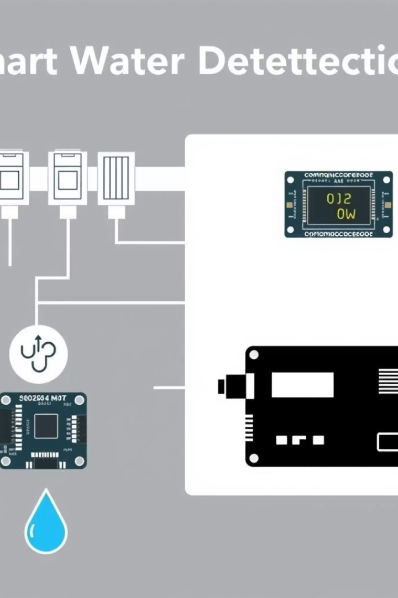




System Architecture: Sensing & Alerting
The system architecture integrates various components for effective detection.
Sensors
Detect water presence and levels.
Microcontroller
Arduino processes sensor data.
Communication
Alert messages or LoRa for long-range.
Power
Battery or solar panel with controller.
Data is processed locally, and alerts are dispatched rapidly.
Notes:
4

Slide 5
Core Components & Connectivity
Our system relies on robust, affordable hardware components.
Arduino Uno R3 Microcontroller core, low cost. Acts as a bridge between sensors and alert networks | GSM SIM800L Module Sends alerts to registered numbers. Best For Valleys/Terai (NTC coverage).
Water Level Sensor Capacitive type, detects varying water levels. Detects 20cm → 1m water rise (adjustable for rivers/farms) | Optional LoRa Ra-02 For long-range (up to 10km) rural deployment. Best For Hill districts (no cell towers)
Power options include a 9V battery or a 10W solar panel for continuous operation.
Notes:
5

Slide 6
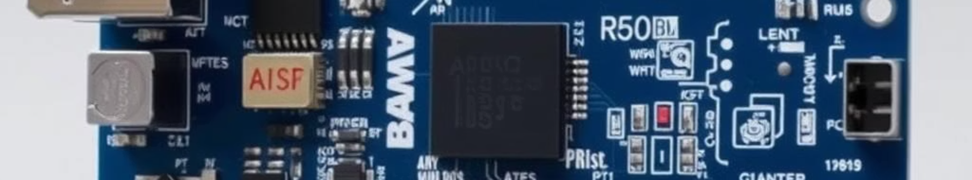
Key Features & Benefits
The Smart Water Detection System offers critical advantages.
Early Detection
Property Protection
Alerts within 3 to 5 seconds of water presence.
Reduces water damage by up to 70%.
Safety
Cost Savings
Prevents 80% of flood-related fatalities.
Avoids average of 100k in damages.
Notes:
6

Slide 7








Deployment in Diverse Environments
Our system is versatile, adaptable to various settings.
Residential Homes
Agricultural Fields
Basements, kitchens, and bathrooms.
Crop protection from flash floods.
Rural Infrastructure
Schools & Health Posts
Bridges, roads, communication towers.
Safeguarding community assets.
It is designed for easy installation and local adaptation.
Notes:
7

Slide 8
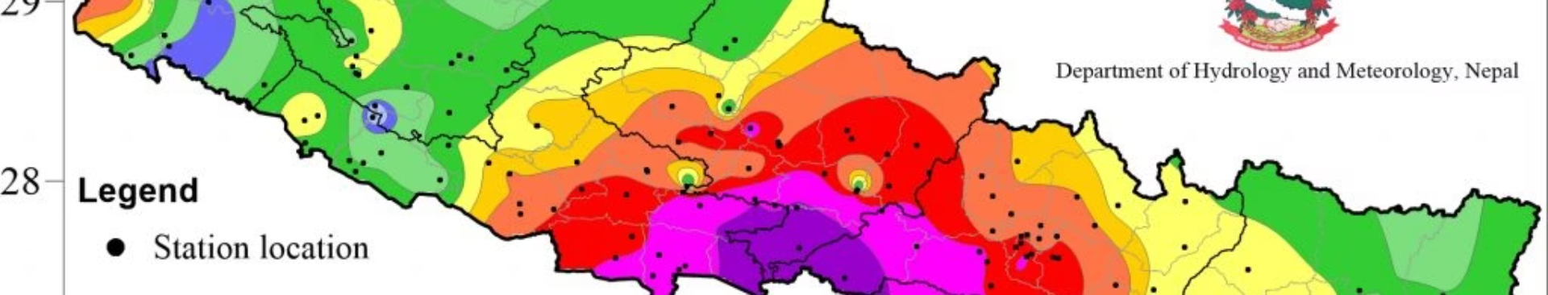
Real-World Impact: A Hypothetical Case Study
Implementing flood yields substantial benefits for communities.
$1M
10-15
15%
Avoided Damages
Lives Saved
Disease Reduction
Estimated annual savings.
Potential annual reduction.
Lower waterborne outbreaks.
Equipping 500 households could save millions and protect lives.
Notes:
8

Slide 9


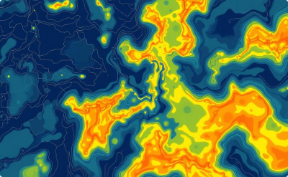
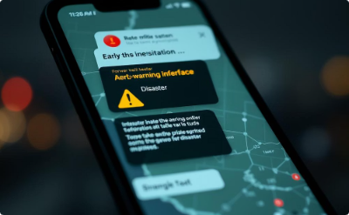
Scalability & Future Vision
Our system is designed for future expansion and integration.
Network Integration
IoT Platform
Machine Learning
Early Warning System
Community-wide mesh networks.
Cloud data logging, predictive analytics.
Predictive flood pattern models.
Integrate with disaster management.
This paves the way for autonomous response capabilities in critical infrastructure.
Notes:
9

Slide 10
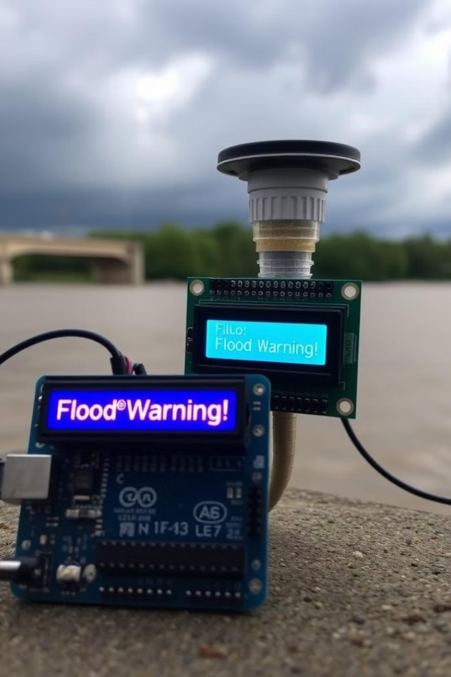
Conclusion: Protecting Lives, Securing Futures
Our system offers a proactive solution for Nepal's monsoon challenges.
We empower communities with crucial early warning capabilities.
Leveraging accessible technology, we aim for significant impact.
We seek partnerships to deploy flood across vulnerable regions.
Notes:
10

Slide 11

Thanks For the Opportunity
Presented by :
Abhishek Dhakal Shrijan Prokhrel
Sushank Ghimire Sudip Bhattarai
Sudin Prasad Kafle
Notes:
11

